Slide 1
SQL Advanced Concepts

Slide 2
Goals & Faiday
Querying from the results of other queries.
Enhanced Transformations.
Better Organized.
Faster Queries

Slide 3
Sub Queries
Also known as nested queries.
Alloows to answer complex answers.

Slide 4
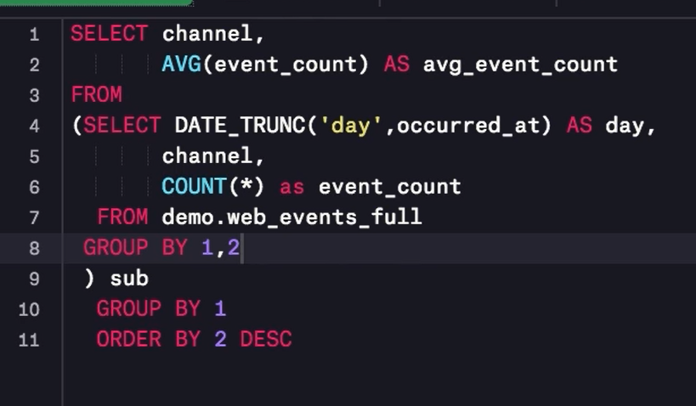
Sub Query Structure
Wrap the inner query in brackets.
Put this in the from clause.
Add an alias to the subquery, it is required.
Treat the result of the inner query as a table.
First inner query runs on its own.
The outer query will run across the result set created by the inner query.

Slide 5
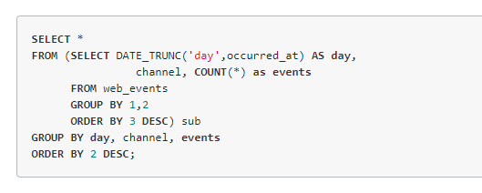
Sub Query Formatting
Indent the sub-query properly.

Slide 6
Subquery with WHERE, HAVING, Select, When in case
If the nested or sub query is only returning single value than we can also use it in the select, where & having clause.
In this case, we don’t use alias since using sub query as a condition is treating the result as a value rather than a table.
If we returned an entire column IN would need to be used to perform a logical argument.

Slide 7
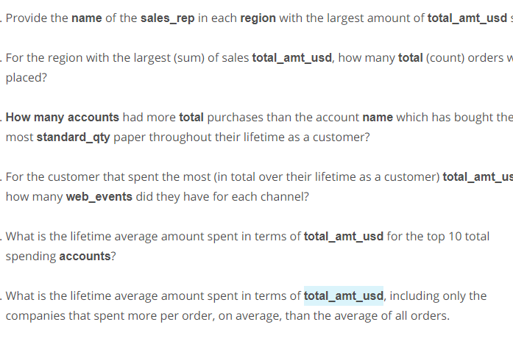
Questions
Notes:
Answers in the notepad file in the folder.

Slide 8
With Statement – Common Table Expression
Why do we need CTE ?
Answer: if we have a subquery that takes really long to run, we might want to run it as a completely separate query, let it run & than write it back into the database as its own table.
Than we can simply query that table as any other table to get the required results.
Speed is improved. Speed is important.

Slide 9
Problem with SubQuery
Makes the query length & difficult to read
Difficult to compare, analyze the sub query results.
CTE can help break the query into sperate statements for better understanding & readability.

Slide 10
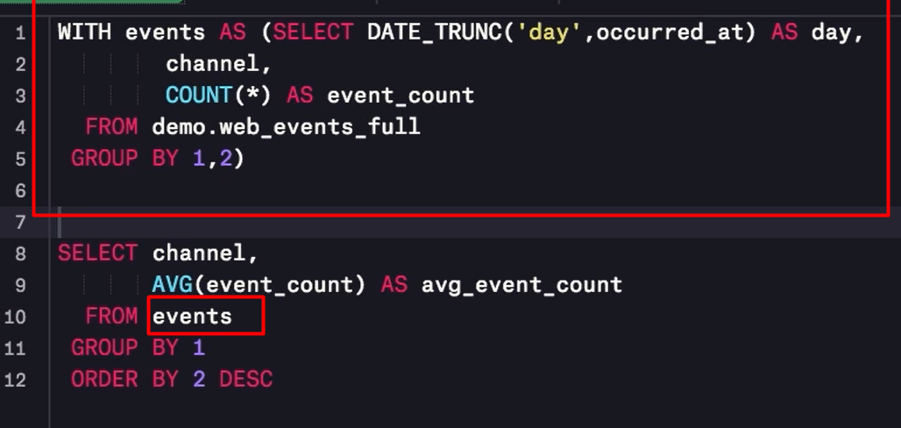
With Command
We use WITH command.
Each CTE gets an alias which is events in this example.

Slide 11
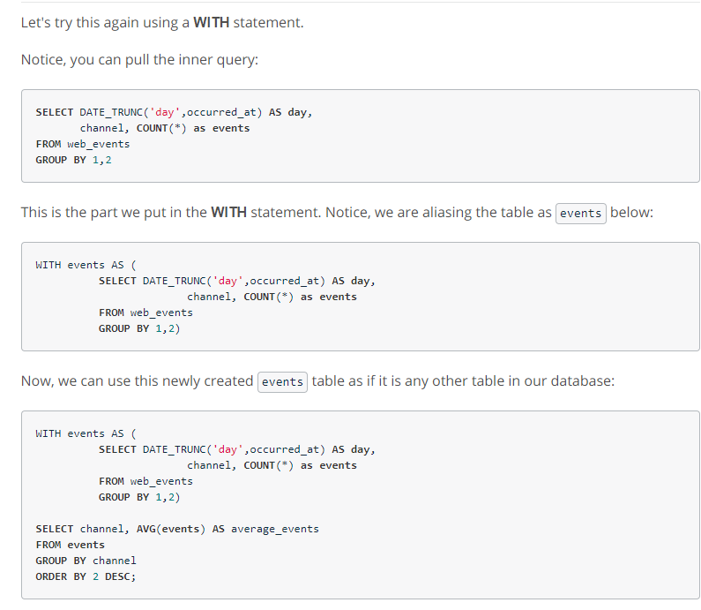
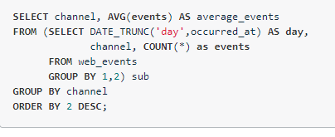
Examples – With Vs SubQuery
QUESTION: You need to find the average number of events for each channel per day.

Slide 12
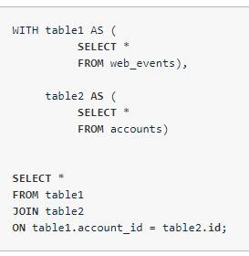
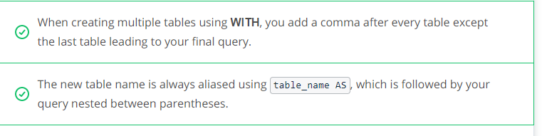
Adding Multiple Tables in With Clause
We can have multiple tables in the with clause. This again improves the readability.

Slide 13
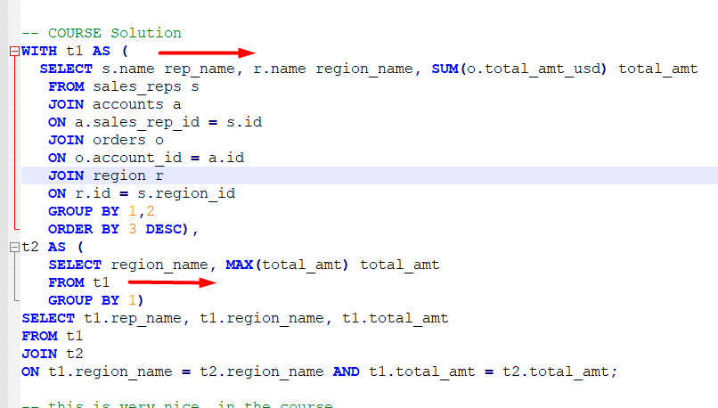
With Section – Questions
When we have created a table in the with clause we can use its result in the next table as well even if it is another with table.

Slide 14
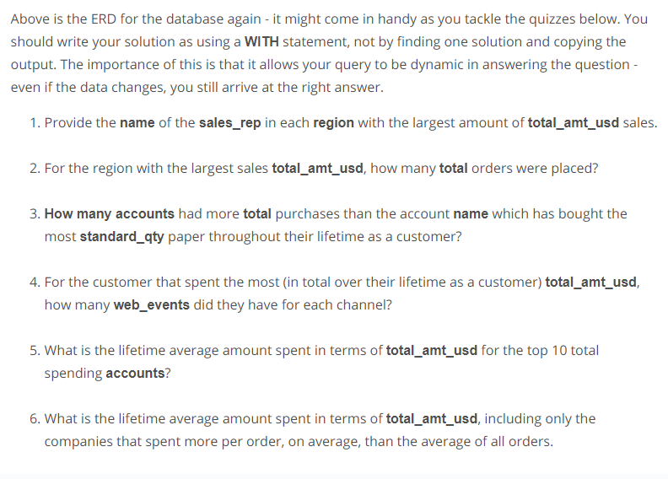
CTE Questions

